Slide 1
CS688 Summer 2019 Term Project Sports Data Analytics
Krishanu Ghosh 8/8/2019

Slide 2
Agenda
Data Description
Exploratory Data Analytics
Google Visualization
World map of Basketball World Cup winners visualization
Backup Slide - Second project – Twitter Sentiment Analysis and mapping with Stock market movement

Slide 3







Sports Data Analytics – NBA season 2007-08
Dataset used
SportsAnalytics API for R - fetch_NBAPlayerStatistics
Exploratory Data Analytics with Boston Celtics data
Which player has the best three point percentage?
Which player has played the most minutes?
Which player has the most "Steals"?

Slide 4
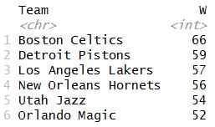
Sports Data Analytics – NBA season 2007-08
Dataset used
Kaggle - https://www.kaggle.com/boonpalipatana/nba-season-records-from-every-year#Team_Records.csv
Top teams for the 2007 2008 season that have the most wins

Slide 5
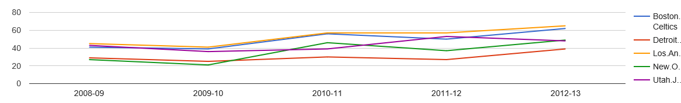
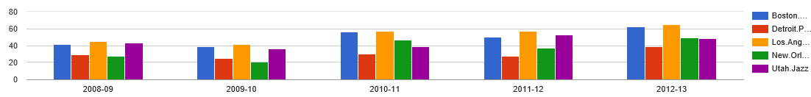
Data visualization with Google Visualization
Line graph of wins of top 3 of 2007-08 over next 5 years
Columns chart to compare wins of Show 5 teams of 2007 2008 over next 5 Years

Slide 6
Data visualization with Google Visualization (Contd)
Relative stats of 2007-8 Celtic players on – Games played, Assists, Total points
Team wise Histogram of Total Assists, Total Steals and Total turnarounds

Slide 7
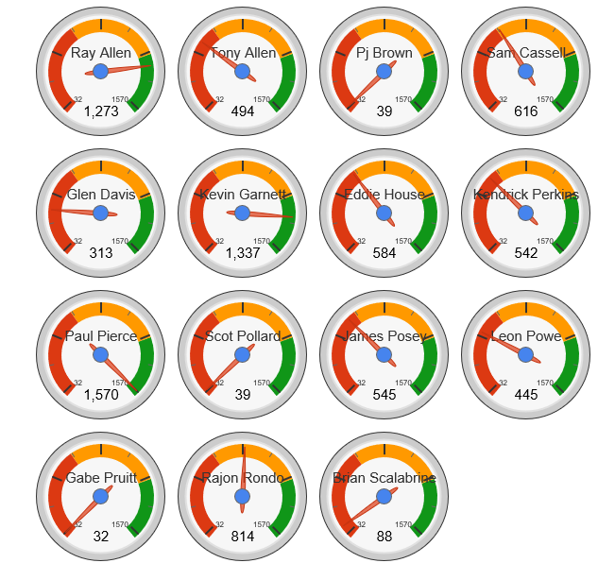
Data visualization with Google Visualization (Contd)
Gauge plot of Celtic 2007-08 Player's Total scores

Slide 8
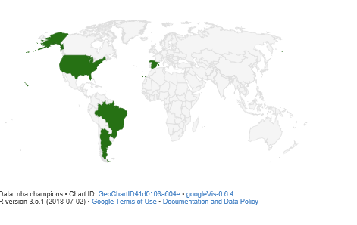
Display on world map all of the Basketball World Cup Champion countries
Data source: http://www.landofbasketball.com/world_cup_stats/medals_by_year.htm

Slide 9
Backup slide - Twitter sentiment Analysis
Select major players in Garment manufacturing and Rental industry
CINTAS
Aramark
UniFirst
Select Twitter posts for a date range to start with and then daily
Data pipeline for Sentiment Analysis and Stock market movement analysis
Calculate Sentiment score online
Fetch Stock prices
Build Dataframe
Populate into a MySQL database in AWS
Data visualization
Read data from MySQL database
Visualize pattern

Slide 10
Questions ??

